Slide 1


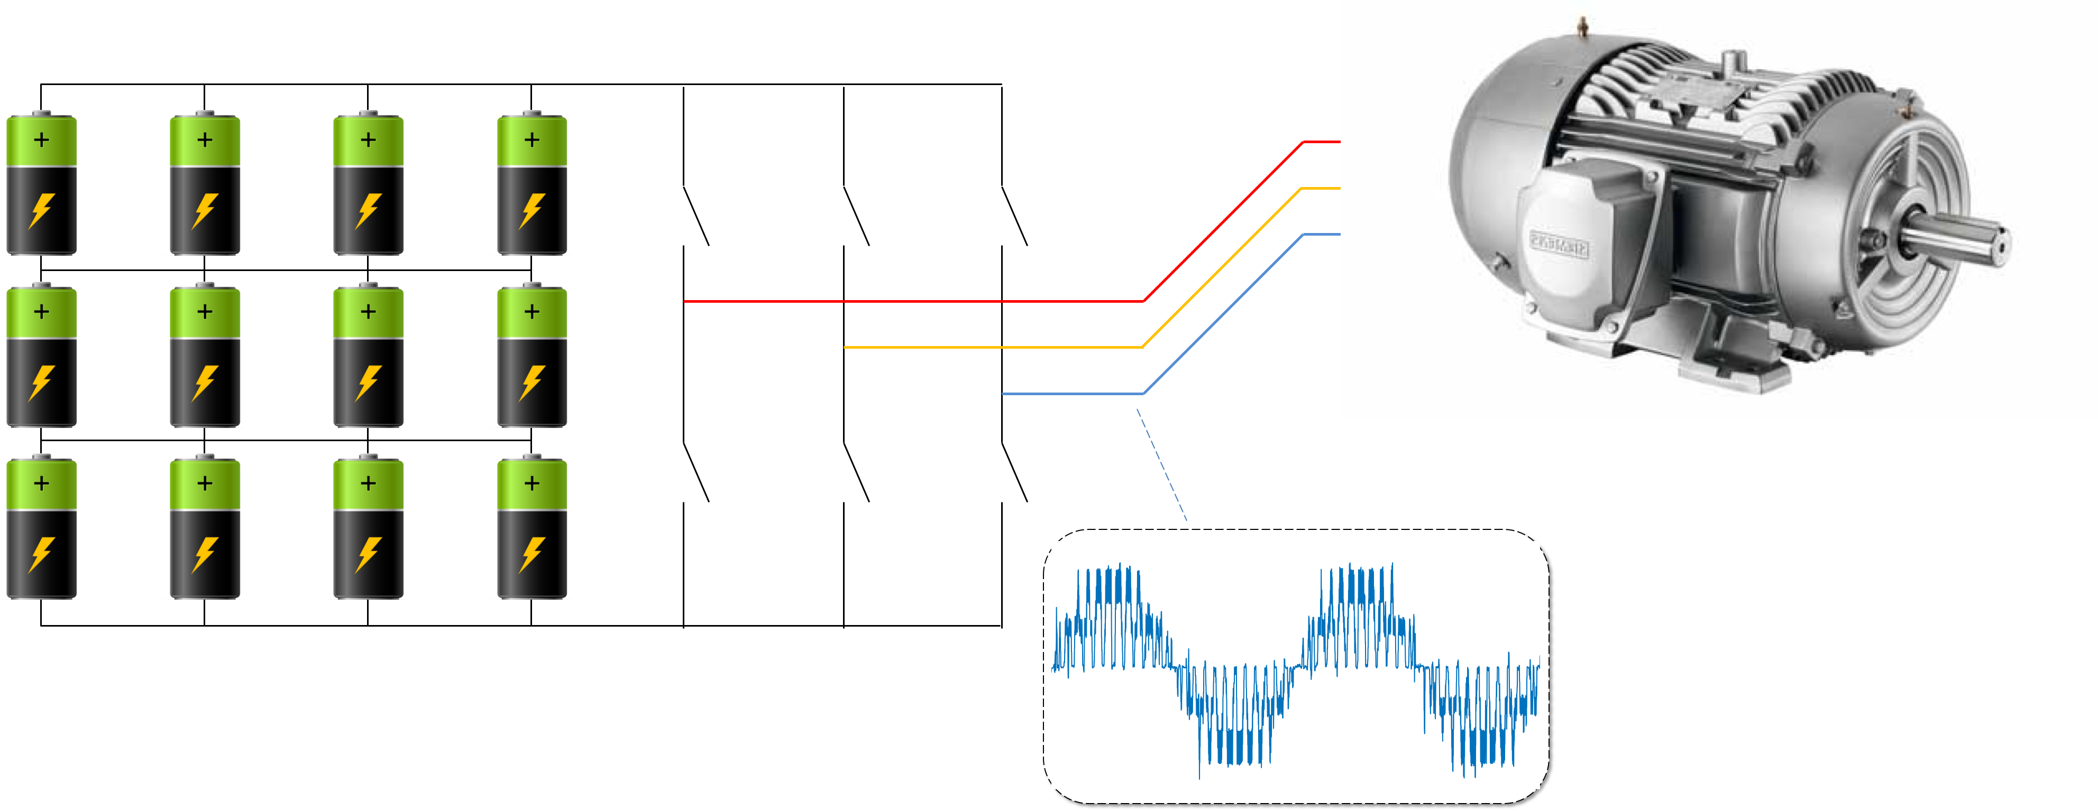
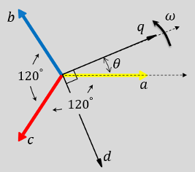
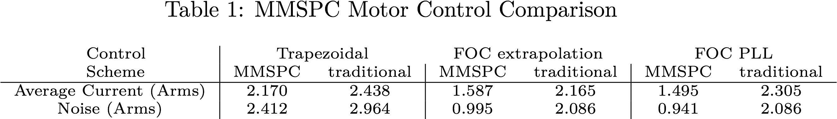

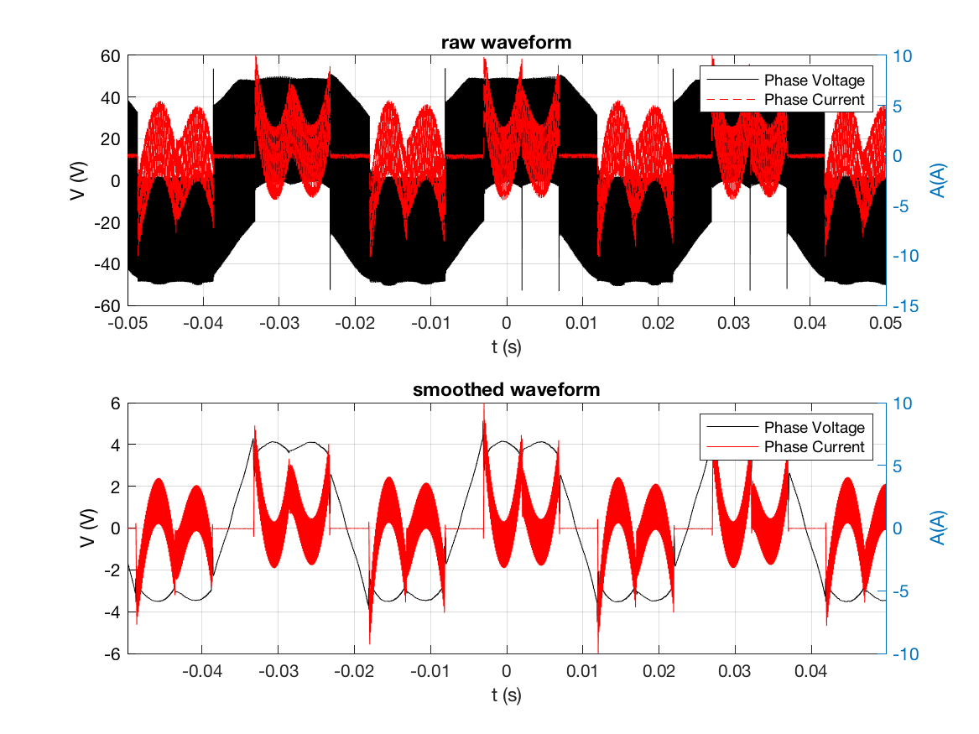
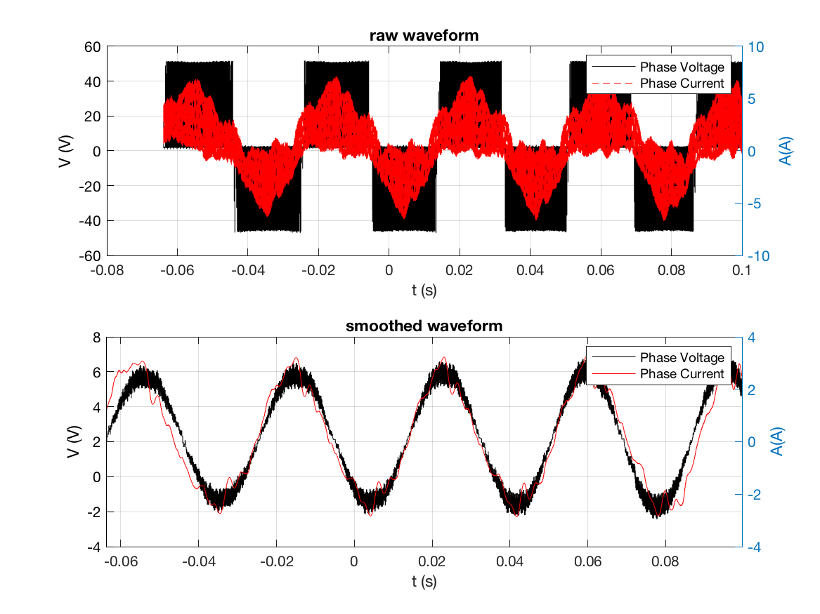
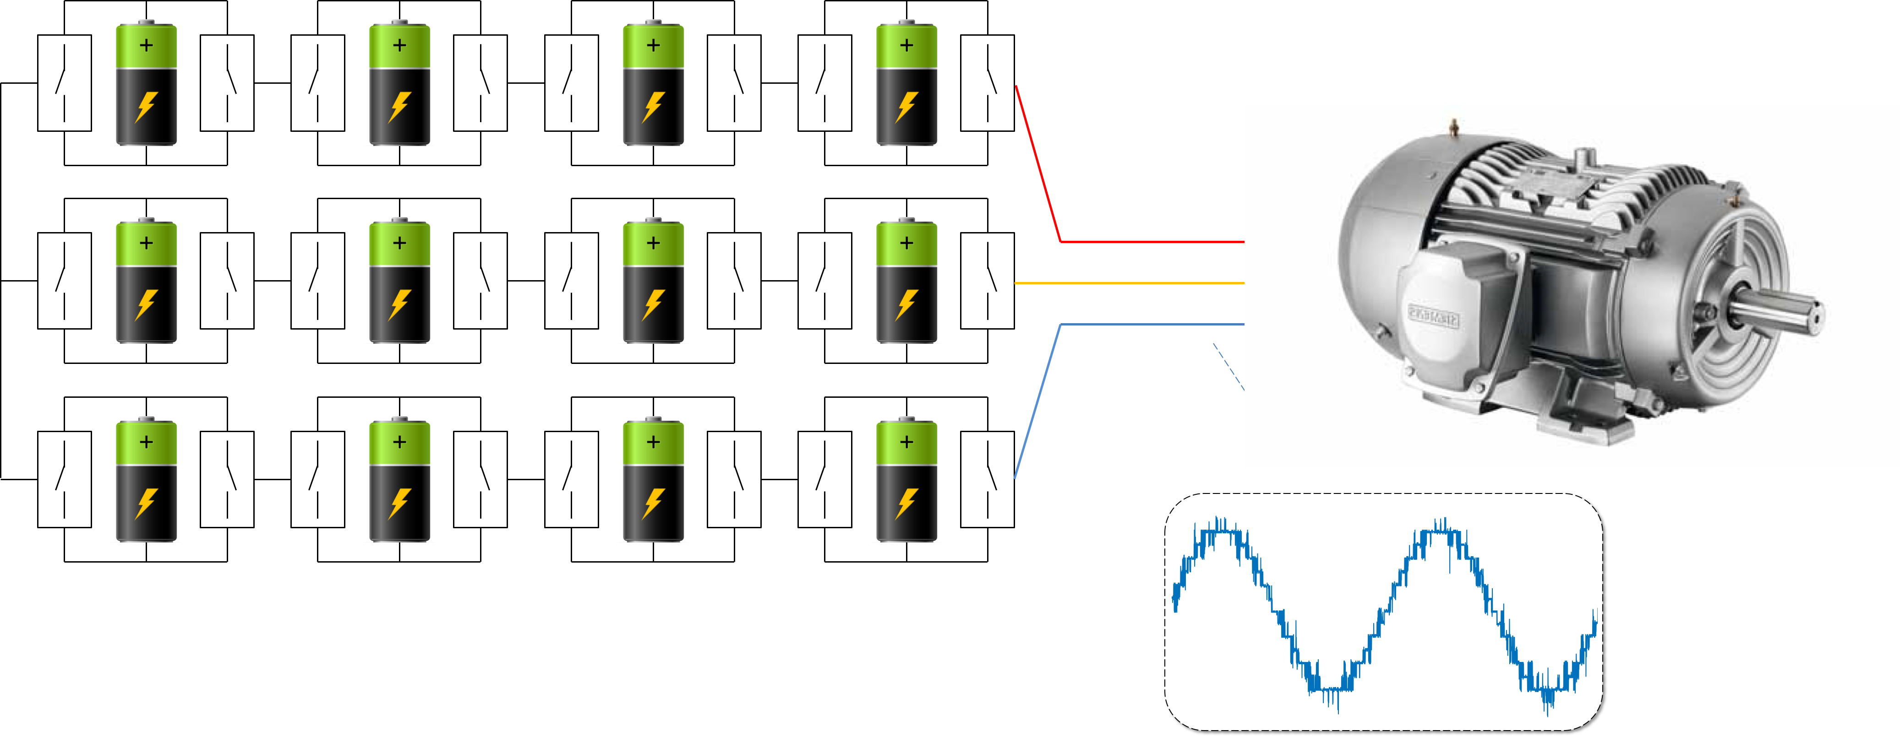
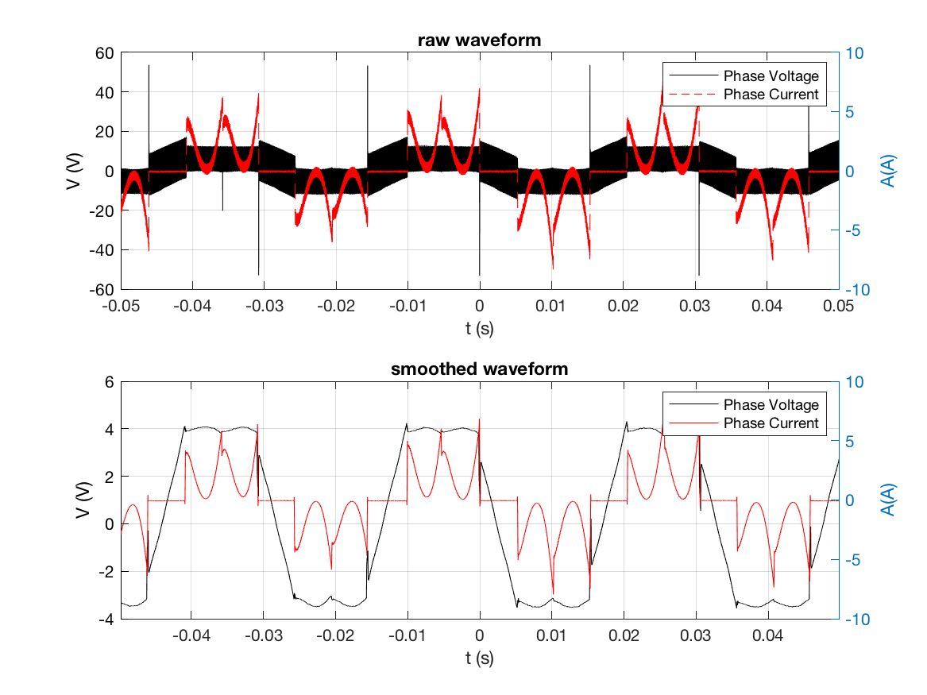
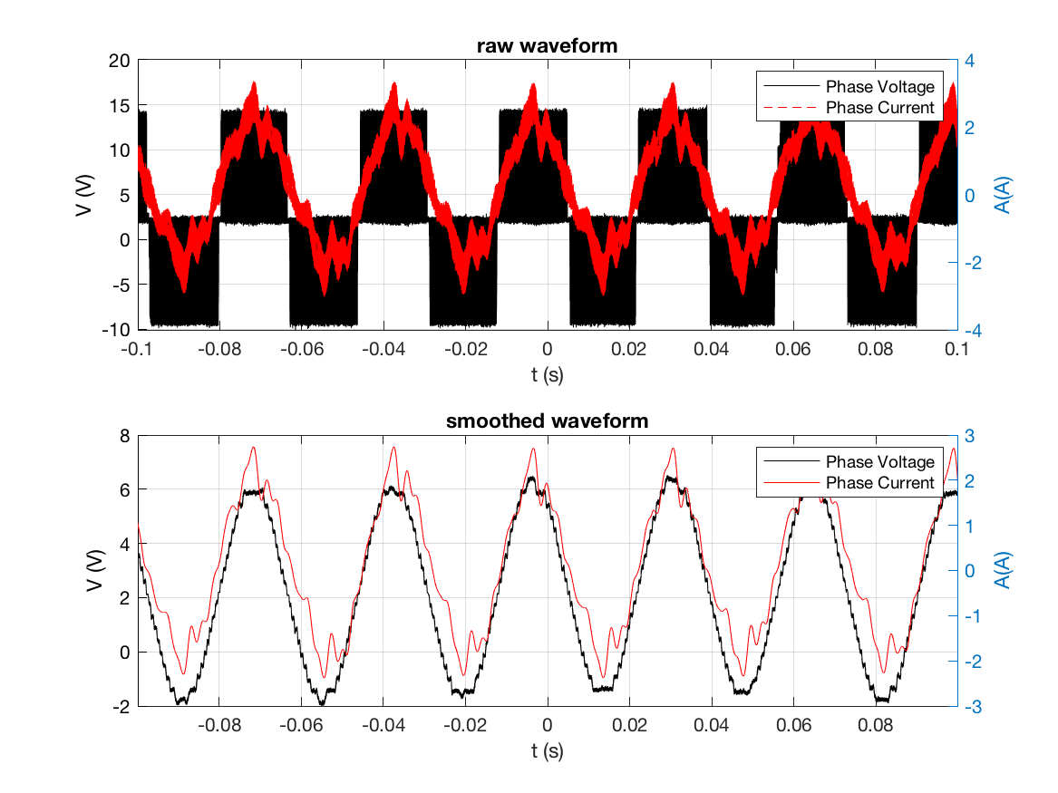
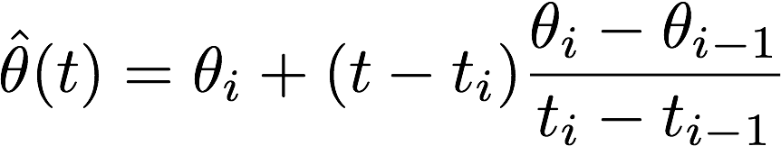
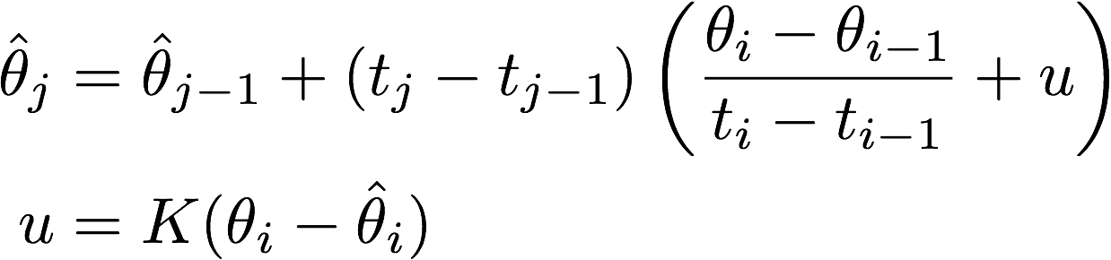

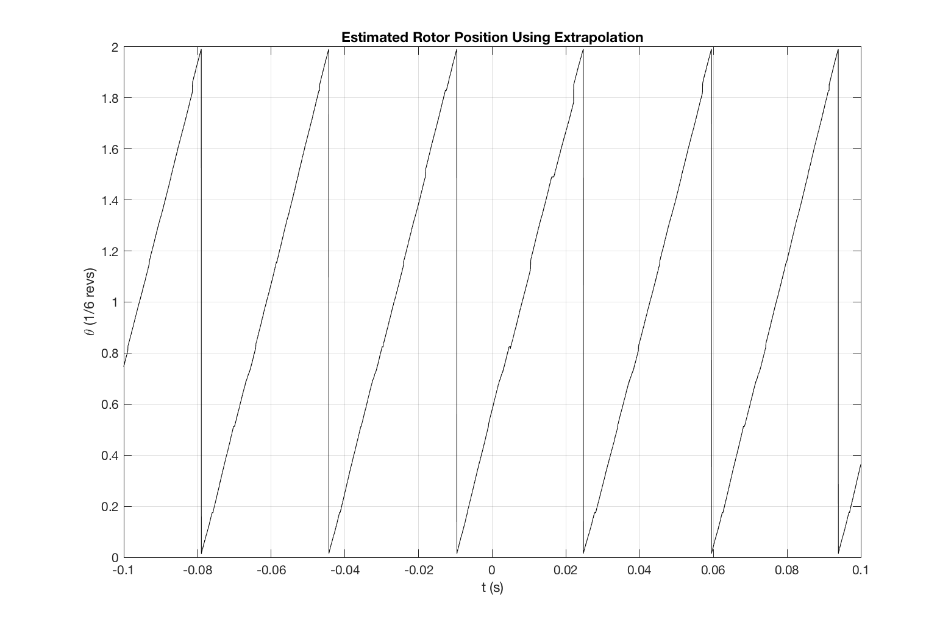
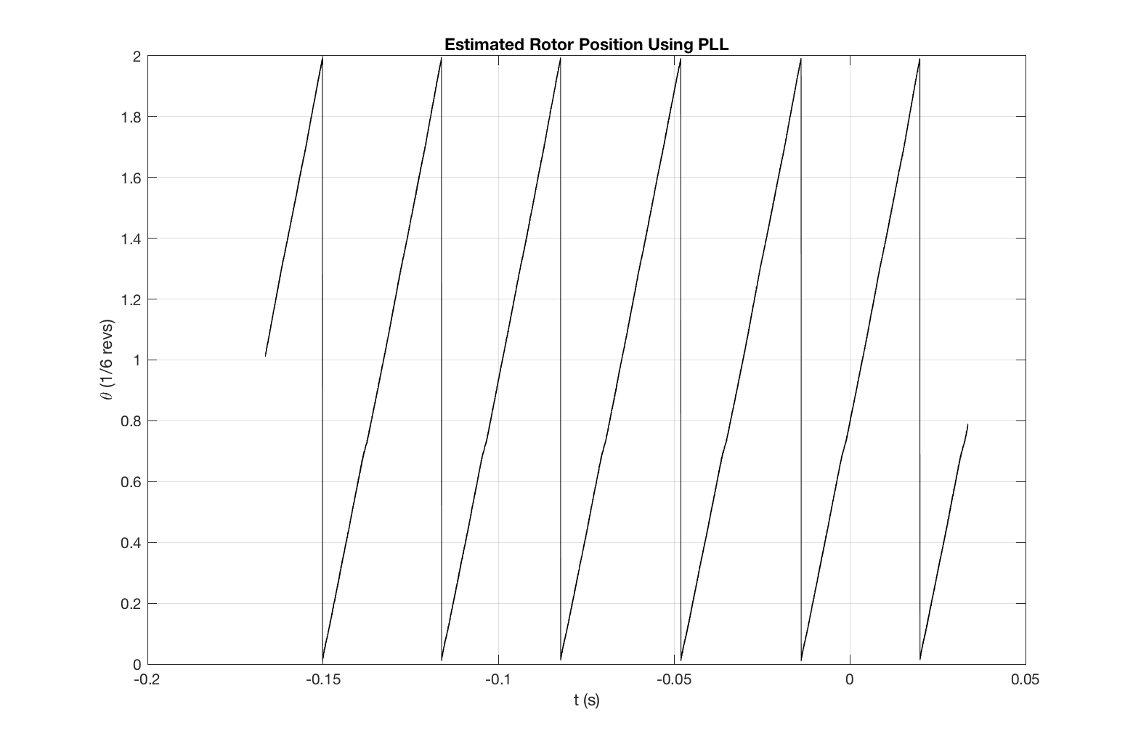

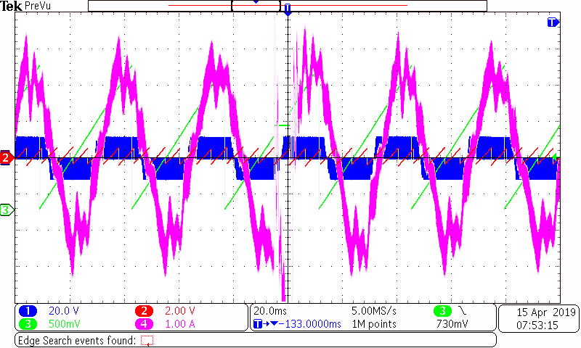
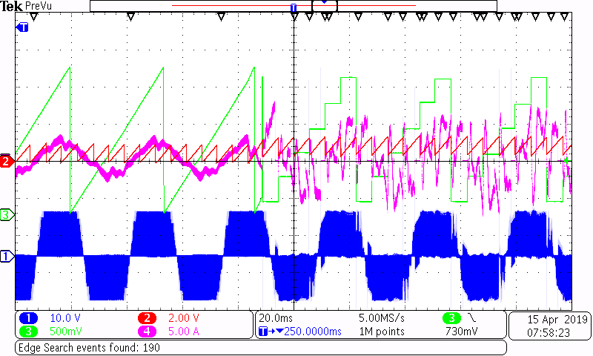
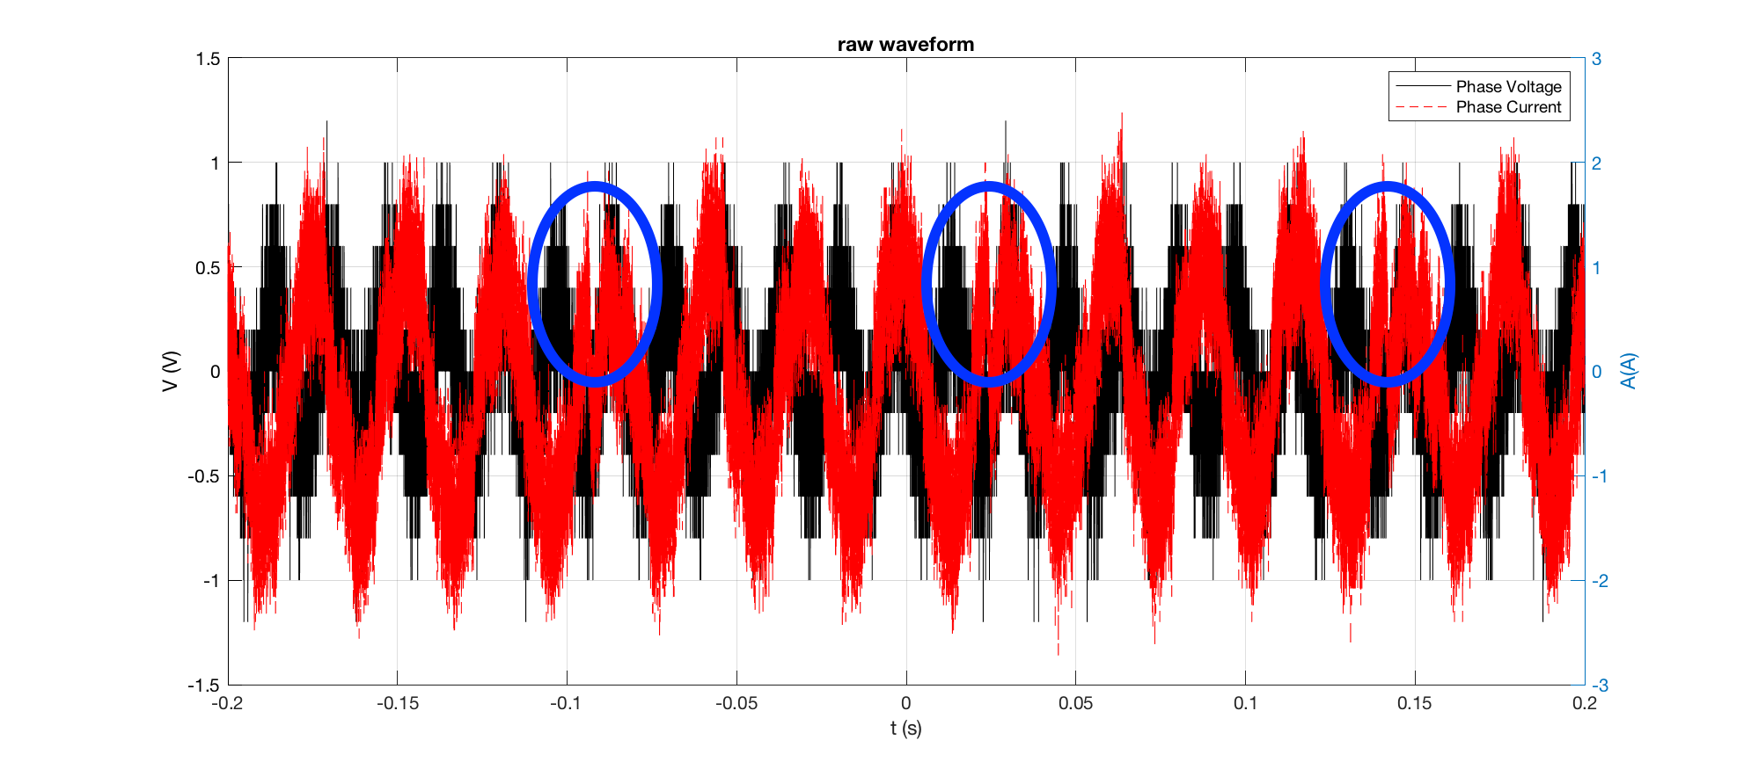
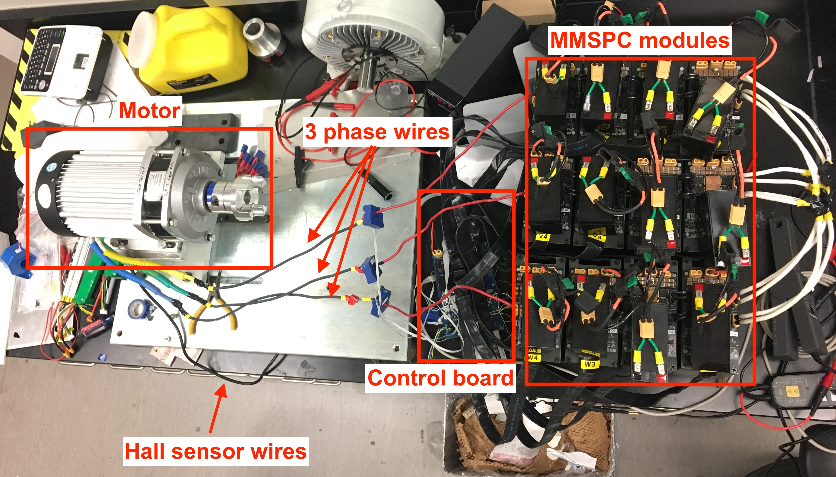
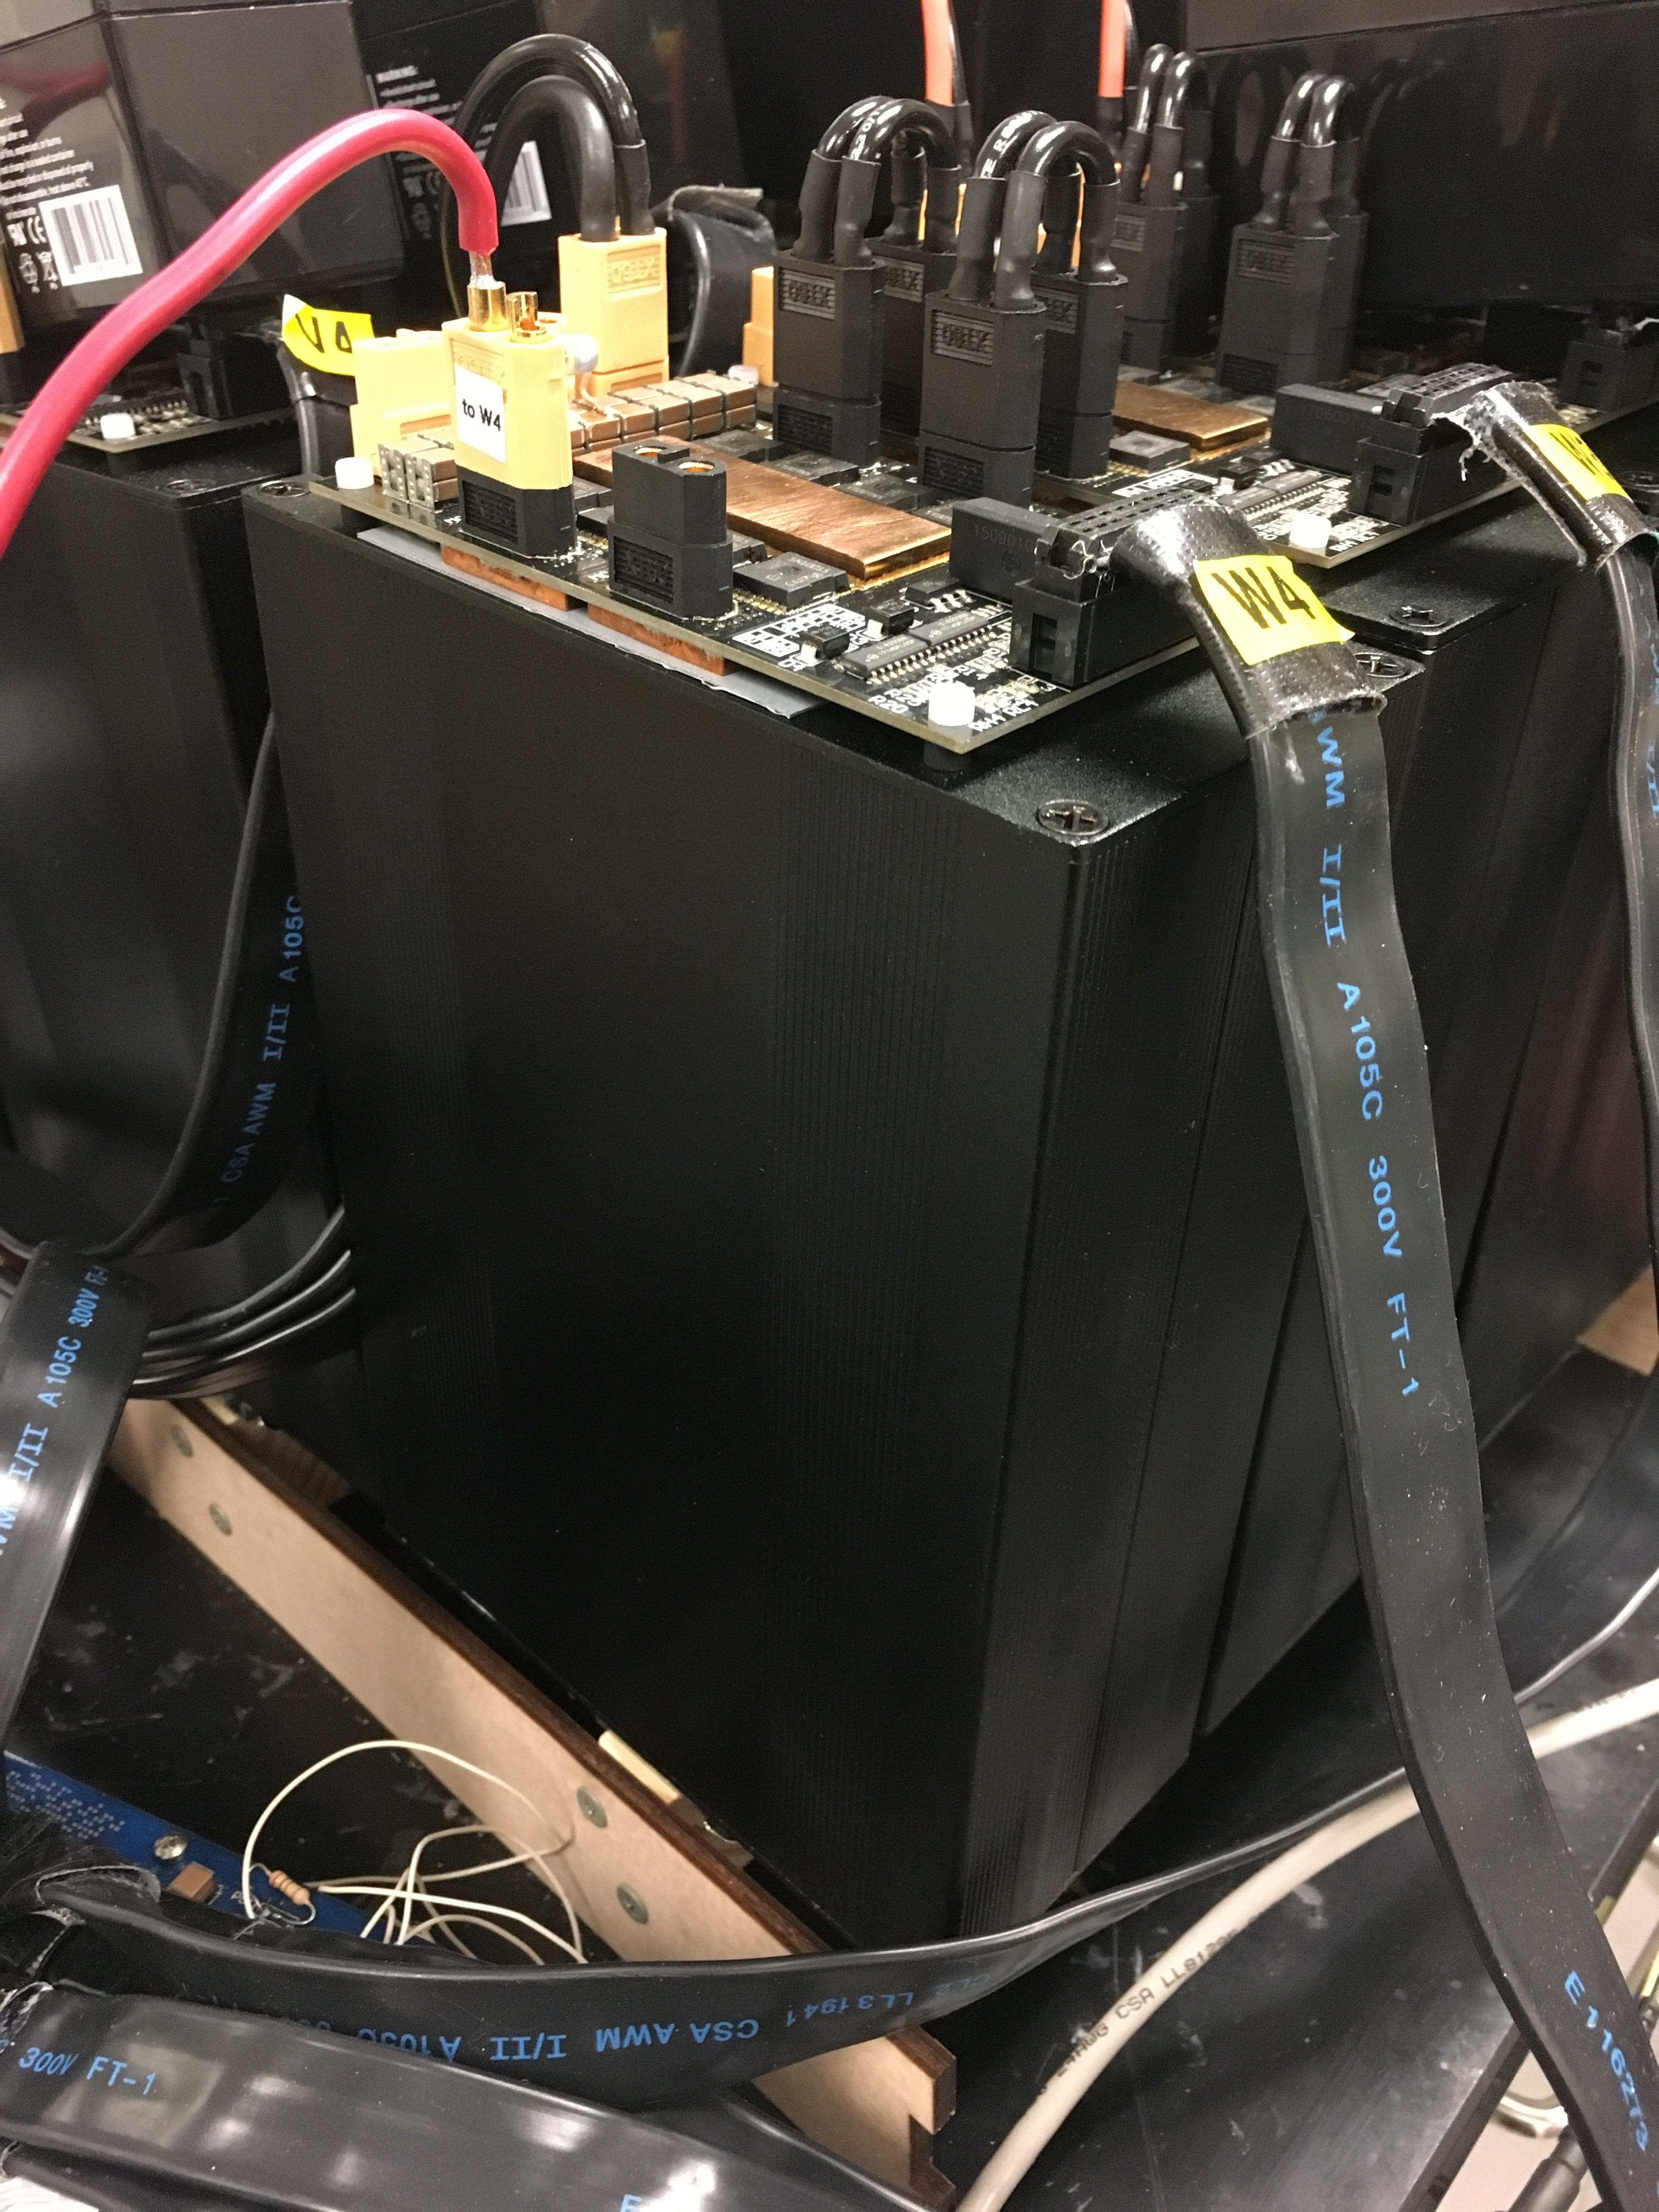
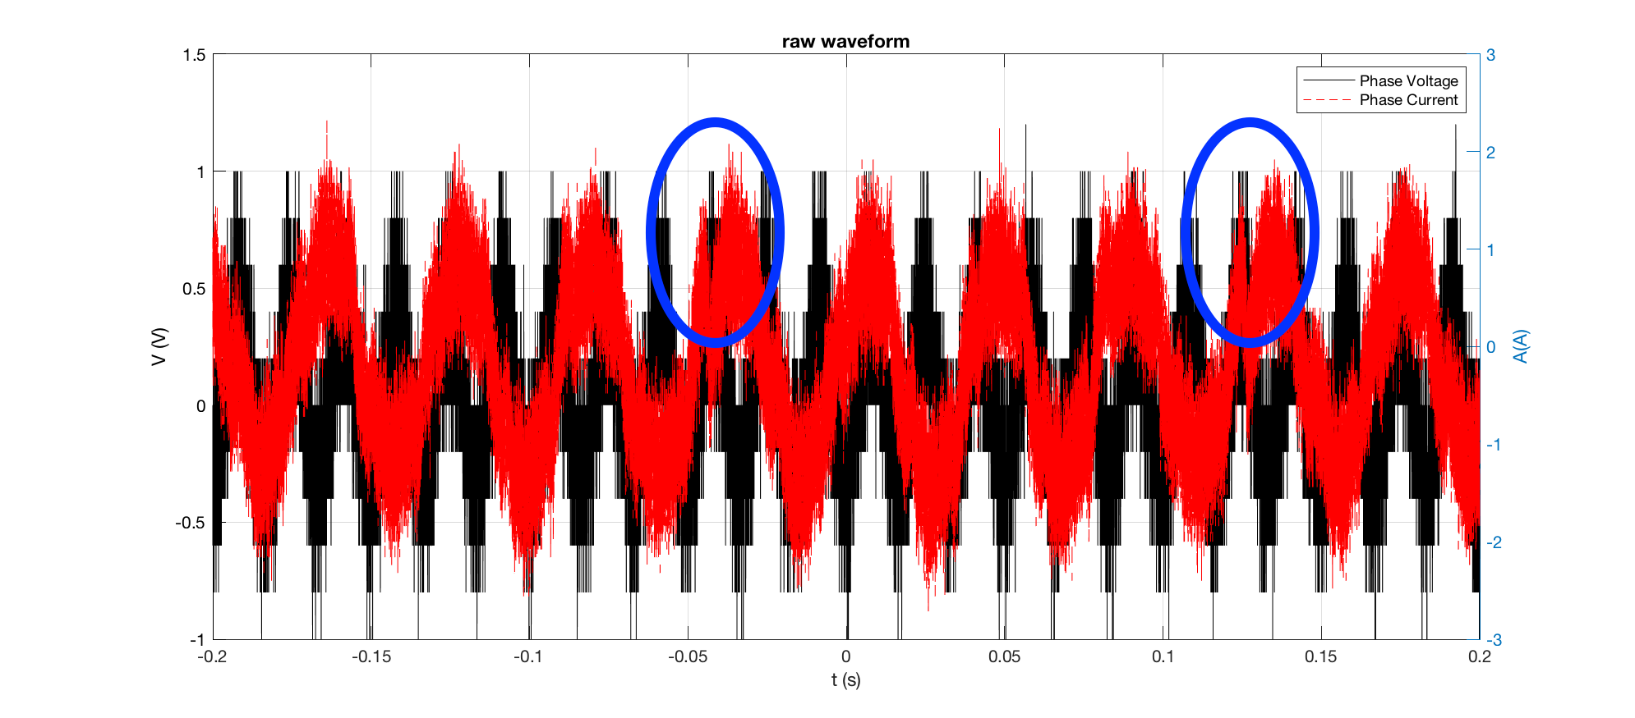
Automotive Application of an Advanced Power Conversion for Brushless Motor Control Gerry Chen, Zhongxi Li, Carol Xia, Raj Borra, Sam Osheroff, Stefan Goetz, Angel Peterchev Duke University, Durham, USA
State of Art Electrical Vehicle and Problems
Rotor Estimation from Hall Sensors
Motor Control
Field Oriented Control (FOC) requires continuous rotor angle estimation for Park and Inverse Park transforms.
mathworks.com
How should we sense rotor angle?
Sensor Method | Pros | Cons
Sensorless (back-emf) | Cheap Works well at high speeds | Reliance on software Less precise/accurate
Hall Sensors | Reasonably cheap Fallback on trapezoidal Robust hardware Reliable control | Must extrapolate from 60° increments Subject to mechanical misalignment
Encoder | Accurate and precise No estimation required | Expensive Prone to hardware failure Sensitive to poor installation
Resolver | Most accurate/precise No estimation required | Most expensive Interpretation of signal is nontrivial
Trapezoidal (traditional)
FOC (traditional)
Hard-wired batteries
Bad fault-tolerance
Needs complex battery management circuit
Controller
Output distortion
Large EMI
Motor
Large torque ripple
Large noise
Large insulation stress
Industry Standard
Our Solution : Intelligent Battery Modules
Two methods for continuous rotor angle estimation using hall sensors:
0th order Taylor extrapolation
Linear extrapolation from previous hall transition
Estimate velocity with low-pass filter on hall transition intervals
Phase Locked Loop
(PLL)
Apply PLL to lock onto hall transitions
Single P controller on velocity to drive angle error to 0
Trapezoidal (modular batteries)
FOC (modular batteries)
Modular batteries ^{[1]}
Battery interfaced by switches
Smart control ^{[2]}
Sensor-less balancing
Minimal losses
Fallback to Trapezoidal Control
High-quality output
Less toque ripple
Less insulation stress
Great fault-tolerance
Hall Sensor Calibration
Legend
Estimated Rotor Position
Phase Current
Phase Voltage
System Test Setup
Small errors in angle estimation cause large spikes in motor phase current waveform.
Intelligent battery module
Before
Pre-calibrate hall sensor misalignment:
Run motor in open loop at constant speed and measure hall sensor timing.
Storing one electrical revolution is insufficient since there are 4 pole pairs: must store 4 revolutions (24 transition times).
Future Work
Remake module mounting array with aluminum base
Mount the system on our test vehicle
Test for auditory noise, torque responsiveness, winding temperature, and electrical-to-mechanical efficiency
After
References
[1] Goetz, Stefan M., et al. "Control of Modular Multilevel Converter With Parallel Connectivity—Application to Battery Systems." IEEE Transctions on Power Electronics 32.11 (2017): 8381-8392.
[2] Z. Li, A. V. Peterchev, R. Lizana, and S. M. Goetz, “Distributed Balancing Control for Modular Multilevel Series/Parallel Converter with Capability of Sensor-less Operation,” in Energy Conversion Congress and Exposition (ECCE), 2017 IEEE, 2017.

